Slide 1



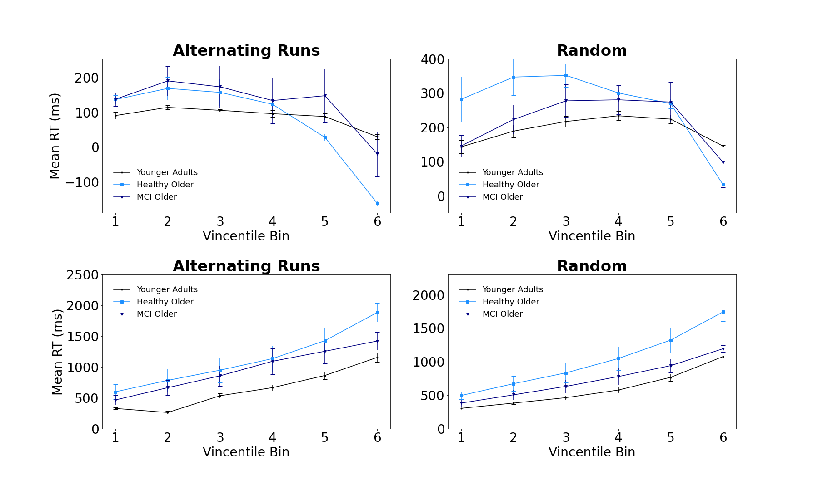
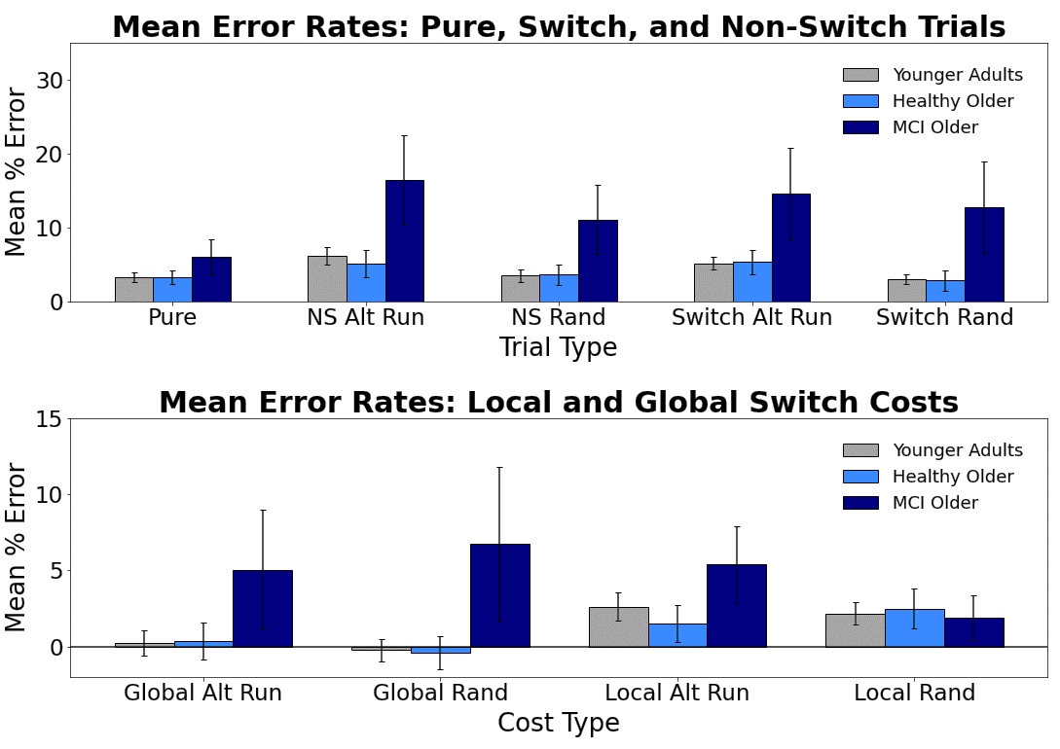
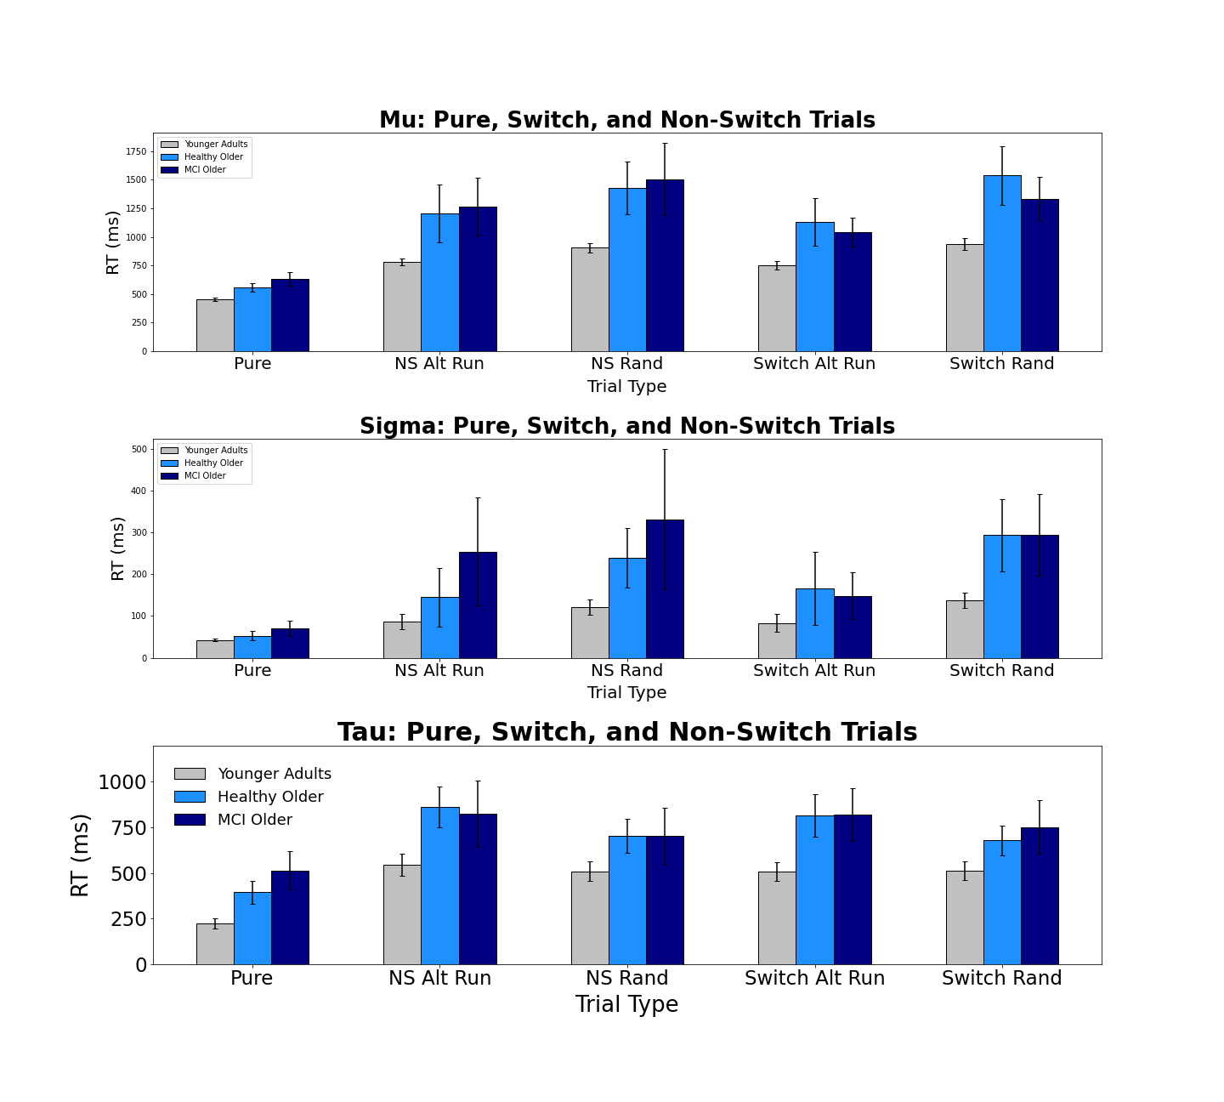
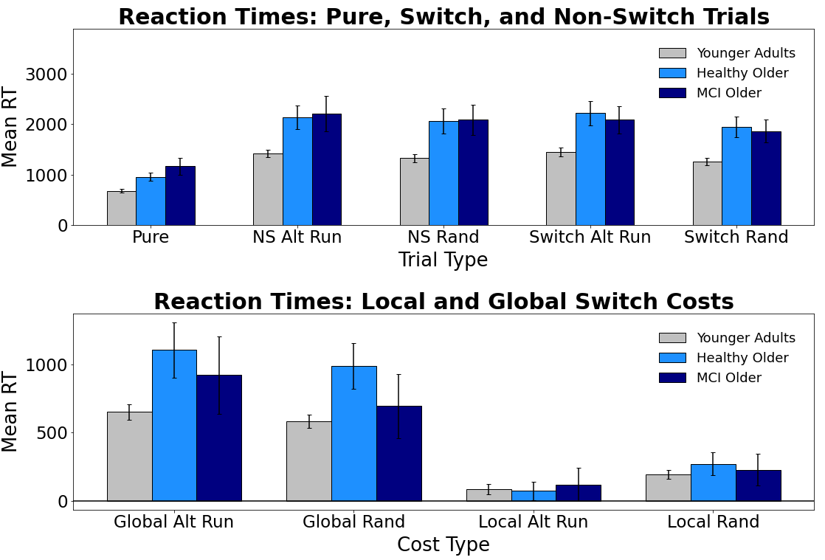
Evaluating Switch Costs using Alternating-Runs and Random Sequencing in the Consonant-Vowel/Odd-Even Task in Younger, Healthy Older, and Mildly Impaired Older Adults
Jacob M. Namias, Nicholas P. Maxwell, & Mark J. Huff
Introduction
General Method
Vincentile Plots
In the Consonant-Vowel/Odd-Even switch task (CVOE, Minear & Shah, 2008), participants view bivalent stimuli (e.g., A 08) and quickly classify the letter (Consonant/Vowel) or the number (Odd/Even). Because participants complete both pure blocks (e.g., all trials are the CV task) and switch blocks (e.g., participants switch between both classification tasks), this task allows for comparisons between global and local switch costs. Global costs (i.e., non-switch trials - pure trials) represent the cost of keeping multiple task-sets active in working memory. Alternatively, local costs (i.e., switch trials - non-switch trials) reflect task-set reconfiguration processes that occur due to switching tasks within the same block.
Previous research has found that global costs for both errors and response times (RTs) increase with age and for individuals with mild cognitive impairments (MCI; e.g., Alzheimer's Disease), while these conditions decrease local costs for RTs (Huff et al., 2015). Furthermore, Huff et al. showed that distributional analyses of RTs (e.g., Vincentile plots) can be used to further investigate this dissociation between costs.
CVOE studies often present switch trials via a predictable, alternating runs sequence (e.g., CV, CV, OE, OE, CV, CV). The present study expands upon this by comparing predictable switching with random switching in which there is no discernable pattern. Specifically, we investigate the effects of random (vs. predictive) switching on younger, healthy older, and MCI older adults. We then assess changes in mean errors, RTs, and switch costs as well as RT distributions using Vincentile plots and an ex-Gaussian analysis. We expected participants would find the random switching task more difficult, and that these difficulties would be reflected in greater error rates and RTs compared to alternating runs switching. Given breakdowns in working memory and attentional control processes that are associated with AD, we expected that MCI older adults would particularly struggle with the random switch task. Thus, we expected that differences in switch costs previously found using alternating runs would be particularly exaggerated for these individuals when switching was non-predictive.
Pure Blocks
Switch Blocks
MoCA
Local Switch Costs
Note: Participants completed four blocks (CV, OE, Alt Runs, and Random). The first two blocks always contained pure trials (CV or OE). The final two sets of trials were always switch blocks (Alt Runs or Random).
Global Switch Costs
Results: Mean Errors
Ex-Gaussian Analysis
Bars = 95% CI
Bars = 95% CI
Conclusions
Results: Mean RTs
Bars = 95% CI
Overall, MCI older adults produced more errors compared to younger and healthy older adults. Additionally, both older adult groups were consistently slower when responding. Mean errors and RTs did not differ between alternating runs and random switching. Regarding costs, global error costs did not differ between switch task as function of age group. However, for local error costs, MCI older adults showed greater costs for predictive vs. non-predictive switching. For mean RT switch costs, global costs did not differ as function of switch type. However younger and healthy older adults showed greater local RT costs when switching was random, suggesting that the random switch task was more taxing towards task-set reconfiguration processes.
Next, Vincentile plots showed that local costs decreased for all groups, with these decreases being particularly pronounced for healthy older adults when switching was predictive. Analysis of these plots, however, indicated that local costs did not differ between random and predictive switching regardless of participant type. For global costs, all groups showed steady increases across bins, with no differences as a function of switch type. Finally, an ex-Gaussian analysis of RTs indicated that both older adult groups had greater mean Tau values relative to younger adults, which suggests that older individuals had more responses in the tail of the RT distribution relative to younger adults (i.e., slower task responses). However, no differences occurred as a function of switch type. Thus, it appears that random task-switching can increase local RT costs for healthy individuals, however these increases are not captured by RT distributions.
Participants
Group | n | M Age | % Female | M MoCA
Younger Adults | 89 | 19.67 | 66% | 28.36
Healthy Older | 33 | 73.92 | 75% | 27.75
MCI Older | 26 | 75.88 | 41% | 24.00
Materials
Letters: A, D, E, H, I, J, I, P, S, U
Numbers: 1-99
Pair
A 15
D 04
E 23
H 36
Task
CV
CV
OE
OE
Correct Response
P
Q
Q
P
Correspondence can be addressed to jacob.namias@usm.edu.
More info available at: www.macapsych.com | https://osf.io/yrdsz/
Bars = 95% CI

